Slide 1
INFORMS Annual Meeting 2026
SEFOP: a Software Engineering Framework for Optimization Programs
Francisco Zenteno Smith
Senior Operations Research Scientist
American Airlines
Every comment here represents my own opinion, and does not represent an American Airlines statement
Notes:
Hook: what is an OR team building?

Slide 2
Doing an analysis v/s building a product
Operations Research (OR) turns data + business needs + mathematics → decision.
An analysis delivers a one-time decision.
A product delivers a recurring decision.
Examples:
Plan the annual fleet composition
Generate the monthly crew schedules
Recover from irregular operations
These products are also known as
decision-support systems (DSS)
Its business value comes from being sustainable over the lifetime of the business need.
Notes:
Hook: sustainability is a software property, how good is it in DSS?

Slide 3
DSS often has weak software practices surrounding the applied mathematics
Decision-support system
Some examples:
No version control
Lack of automated testing
Manual processes to make the system work.
Usage of jupyter notebooks in production.
Unclear software design.
Cultural reasons
Scientists are trained deeply in mathematics, but not in software engineering (SE).
They don’t know the benefits of SE, or they don’t think it is for them.
Technical reasons
DSS has unique challenges deriving from the fusion of applied mathematics and SE.
Software components
  How to automatically test an optimization model?
  How to design the system to be solver-agnostic?
Applied mathematics
Source: Vidoni, Cunico & Vecchietti (2018, 2020); Vidoni (2021); Vidoni & Cunico (2022); Kanewala & Bieman (2014)
Notes:
Hook: can we use AI-assisted tools to fix this?

Slide 4
AI-coding assistants require strong engineering foundations: they amplify your practices
Strong engineering practices
AI
↗ Sustainable acceleration
×
=
Faster delivery + higher quality
Automated testing
CI/CD
Architecture
Weak engineering practices
AI
↘ Accelerated technical debt
×
=
More output + more risk
Manual testing
(or absence)
Manual processes
Unclear design
Source: DORA Research 2025 – State of AI-assisted Software Development (Google Cloud, 2025)
Notes:
Hook: How

Slide 5




SEFOP helps you to build those foundations
github.com/sefop
Software Engineering Framework for Optimization Programs — free & open-source
Train
Lead
Deliver
Agentic
Resources to train your scientists
Lead and maintain software quality
Software templates to help you start
Skills to boost the team productivity
Notes:
SEFOP exists so OR teams do not have to rediscover these practices independently.
Next: example testing a DSS

Slide 6

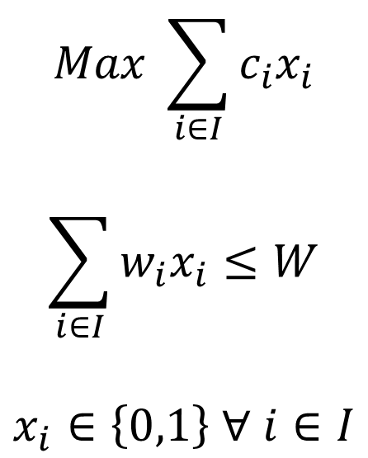
Example: testing a knapsack problem implementation with optimality guaranteed
$$Max \sum_{i∈I}{c_{i}x_{i}}$$
$$\sum_{i∈I}{w_{i}x_{i}≤W}$$
$$x_{i}∈\left\{0,1\right\} ∀ i∈I$$
Knapsack capacity:
500
Maximize calories
Item | Weight | Calories
Chocolate | 500 | 300
Peanuts | 250 | 200
Cheese | 250 | 150
Weight capacity
✓
✓
Binary decisions
Weight used: 500 / 500
Total calories: 350
Notes:
Next: lets define the contract

Slide 7
Example decision-support system
contract
Object
Module
Request
Optimization
Solution
Item | Weight | Calories
Peanuts | 250 | 200
Cheese | 250 | 150
Knapsack capacity: 500
solve(Request) → Solution
Item | Weight | Calories
Chocolate | 500 | 300
Peanuts | 250 | 200
Cheese | 250 | 150
Capacity used: 500
Total calories: 350
System under test
Notes:
Next: how to test this SUT?

Slide 8
List the contract behaviors first*
Solution is optimal
Solution does not exist
… left as an exercise to the reader
Scenario | Given | Then
a | Empty list of products | Calories = 0, Capacity used = 0
b | 1 product that fits | Calories and capacity of that product
c | 1 product that does not fit | Calories = 0, Capacity used = 0
d | 2 products fit | Calories and capacity of both
e | 1 product fit, another does not | Calories and capacity of the product that fits
f | 2 products, but only 1 fits | Calories and capacity of the best product
g | 2 products, only 1 fit, same calories | Calories of any product
h | Case g & Case g with data reordered | Both objectives are the same
* Assume the Request object is well formed (i.e., capacity is not negative).
* These behaviors should be specified in the comments of the contract
Notes:
Next: lets see an example of 1g.

Slide 9
Example test 1g
Scenario | Given | Then
1g | 2 products, only 1 fit, same calories | Calories of any product
Given
When
Then
Knapsack capacity: 500
solve(Request) → Solution
Item | Weight | Calories
Chocolate | 400 | 300
Peanuts | 450 | 300
Capacity used should be 400
Total calories should be: 300
Implicitly here we check cases where there are multiple optimal solutions.
Note we don’t assert the specific solution.
Notes:
You could implement this test in your CI easily.

Slide 10
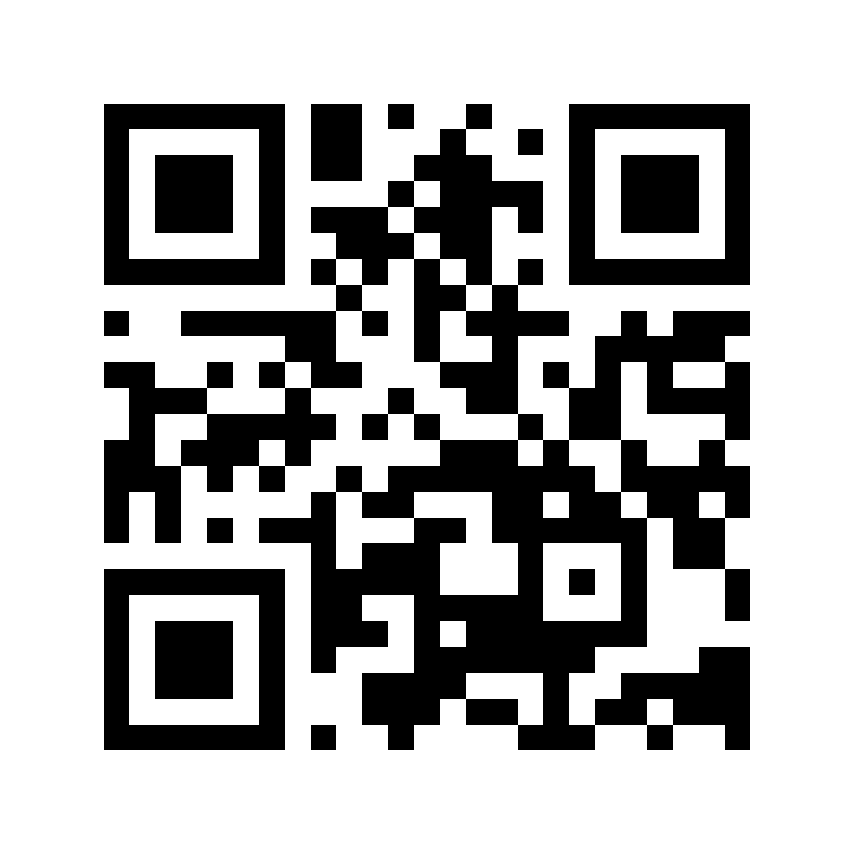
Thank you
github.com/sefop

